Slide 1

Besser Glossary
6.25.24 version 1.0

Slide 2

IntelliBatch 3.0
The software that controls the conveyor belts leading up to the block machine. Also responsible for the mixers and bins.

Slide 3
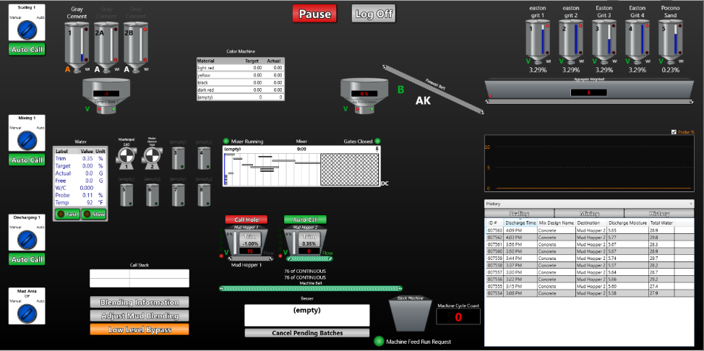
Main View Page
The default page of IntelliBatch 3.0 when you first open the application. Where the majority of actions take place.

Slide 4
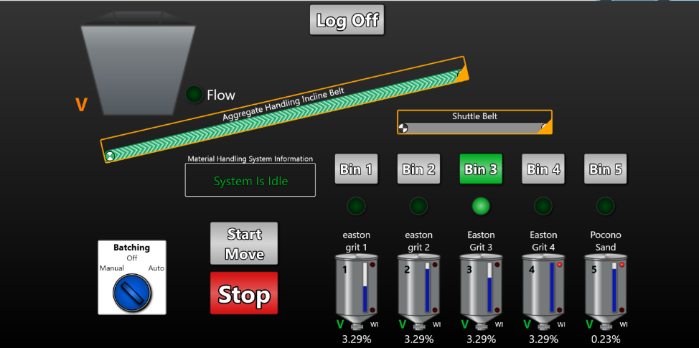
Material Handling Page
The page that controls the conveyors used to refill material bins.

Slide 5
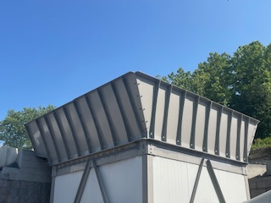
Delivery Hopper
The hopper that dry aggregate from the quarry is dropped into.

Slide 6
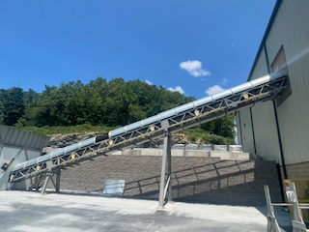
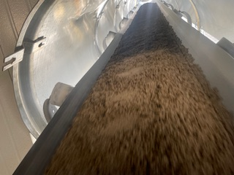
Aggregate Handling Incline Belt
The conveyor that moves dry aggregate into the warehouse onto the shuttle belt.

Slide 7

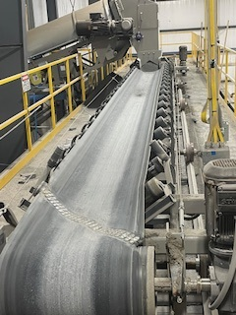
Shuttle Belt
Located above the bins. The conveyor belt that disposes imported aggregate into the appropriate bin. This belt can be activated in the “Material Handling” page in IntelliBatch 3.0. This belt and be run in both forward and reverse directions.

Slide 8
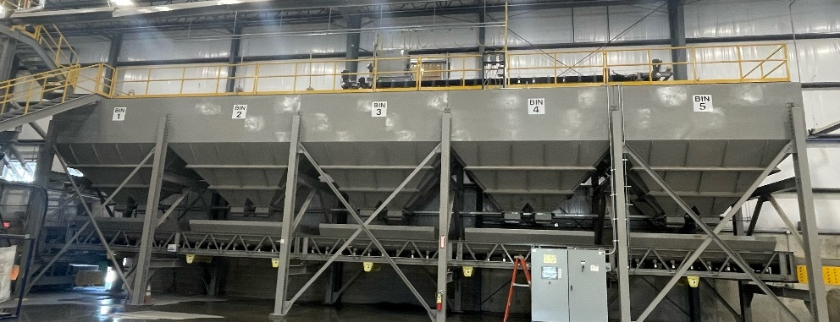
Bins
The compartments that hold raw material for future batches. In the new Besser plant, there are 5 aggregate bins.

Slide 9
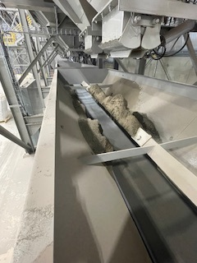
Aggregate Weighbelt
The conveyor that aggregate falls onto from one of the five bins above. Used to measure how much more weight is needed for a complete batch.

Slide 10
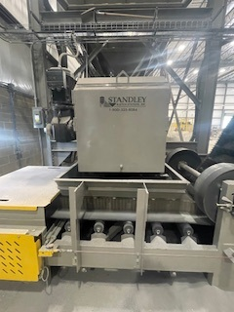
Weighbelt Chute
The chute that drops aggregate from the weighbelt into the flexwall belt.

Slide 11
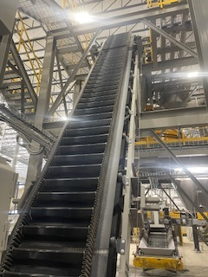
Flexwall Belt
The inclined belt that transports dry aggregate from the weighbelt conveyor into the aggregate hopper for mixing.

Slide 12
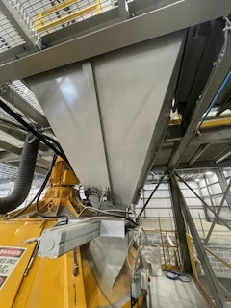
Aggregate Holding Hopper
Holds dry aggregate taken out of the bins and is released when the mixing cycle is ready for that batch.

Slide 13
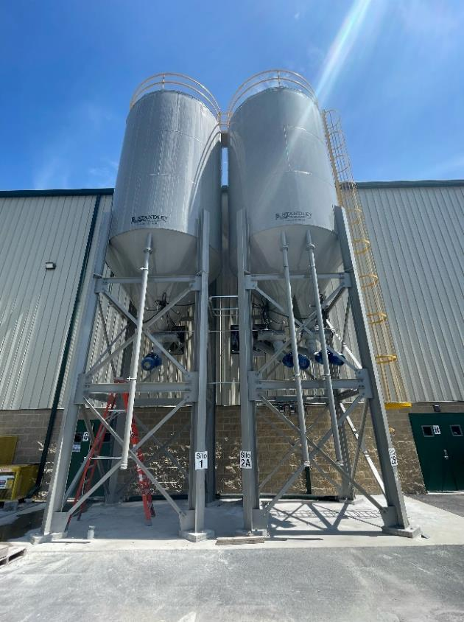
Cement Silos
The silos that holds cement for future batches.
The two silos are actually three silos. The left one is silos #1 and can hold x tons. The right silos is a 50/50 split silos that has two holding containers. These are #2A and #2B and can hold x tons each.

Slide 14
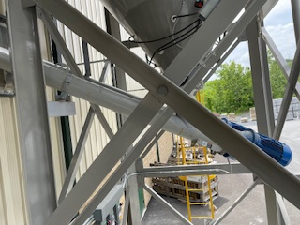
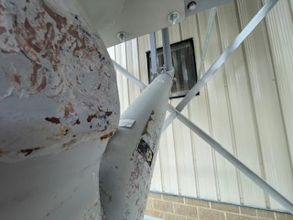
Cement Augers
There are three cement augers coming off of the silos.
Each Cement Auger is a steel tube with a steel auger that transports cement from the silos to the cement hoppers.

Slide 15
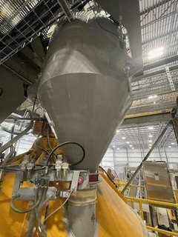
Cement Hopper
Holds cement taken out of the silos and releases it into the mixer when mixing cycle is ready to start for that batch.
The cement hopper utilizes load cells to weigh up cement for each batch.

Slide 16
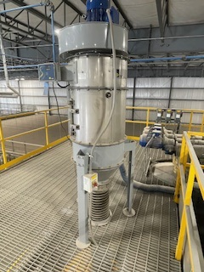
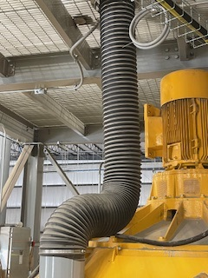
Dust Collector
Filters out particulates that are in the mixer during the mixing process.

Slide 17
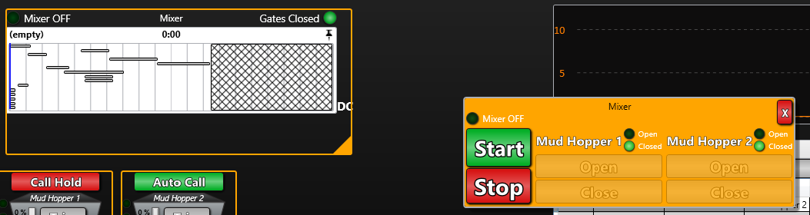
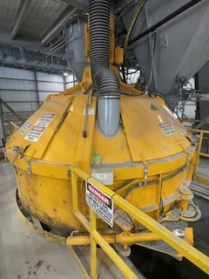
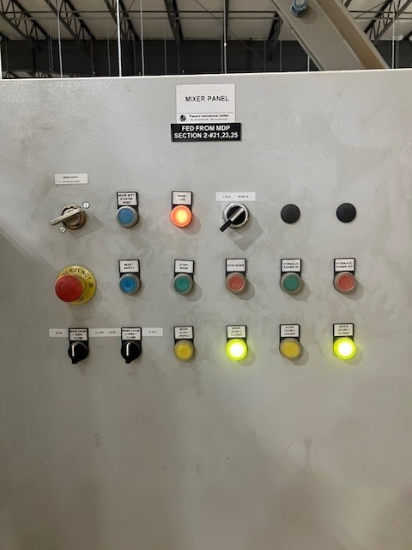
Mixer
Located up the first flight of stairs. The machine responsible for mixing aggregate, water, cement, and admix together. Can be activated remotely by the “Main View” page of IntelliBatch 3.0 or locally by the control panel next to the mixer.

Slide 18
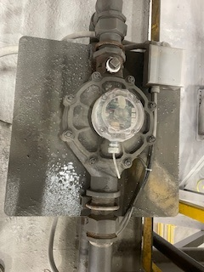
Water Meter
Determines how much water goes to the mixer for batching.

Slide 19
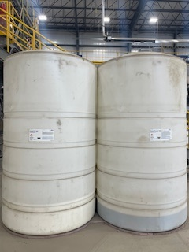
Admix Tanks
Holds the admix and then sends through piping when the mixing cycle is calling for it. The left bin is Eopel which makes blocks water resistant, and the right bin is Glenium (plasticizer).

Slide 20
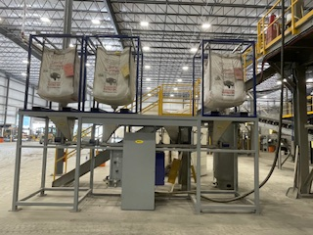
Color Distribution System
Holds bulk bags of granular pigments.
Transports pigment into the mixer for specific color applications in block.

Slide 21
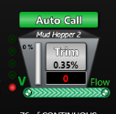
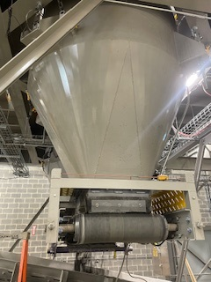
Mud Hoppers
Where mixed material from the mixer drops into.
There are two mud hoppers with hopper #2 used mainly in grey block production. Hopper #1 is used for color blending operations.
Mud Hopper Belt
Where the material in the mud hopper drops onto the machine belt.

Slide 22
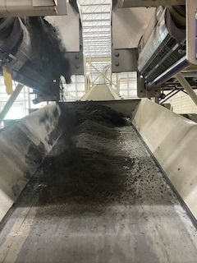
Machine Belt
Where material from the mud hopper belt drops onto. Inclines material into the feed belt hopper at the Besser machine.

Slide 23
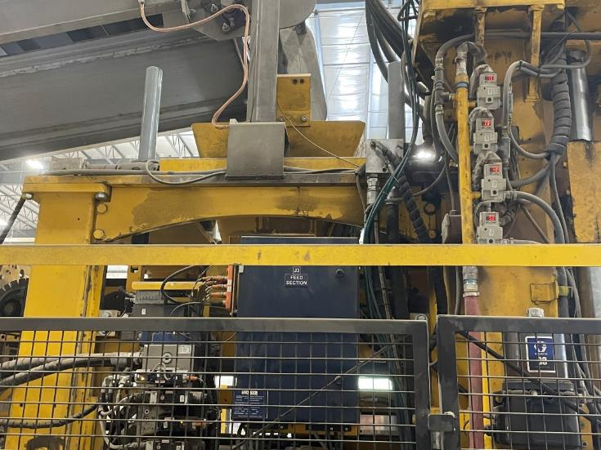
Feed-belt Hopper
Where material from the incline belt is received. Holds material until the feedbox needs it for producing block.

Slide 24
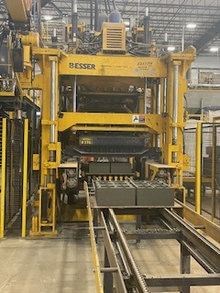
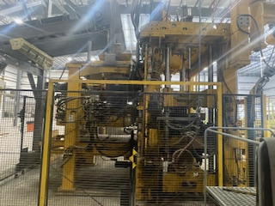
Besser Machine
The machine that takes the material mixture and forms them into cement blocks.

Slide 25
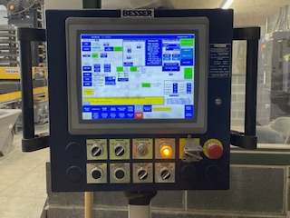
HMI Control Panel
The control panel that controls actions and operations of the block machine.

Slide 26
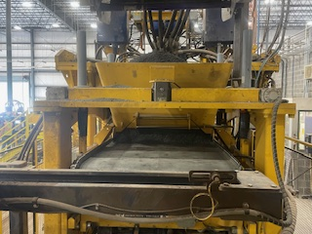
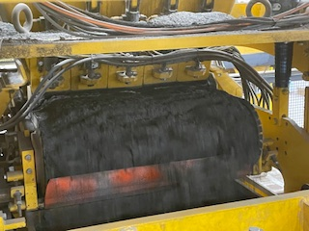
Feed-belt
Back-side
The conveyor belt that distributes material into the feedbox.
Front-side

Slide 27
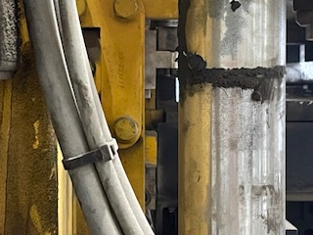
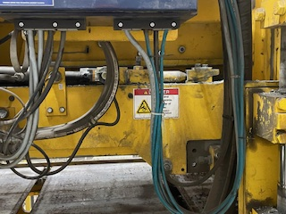
Apron Plate
The platform that holds the feedbox.

Slide 28
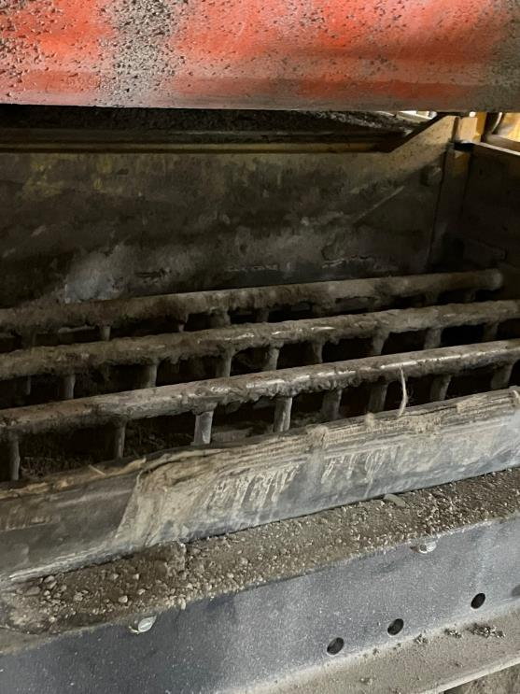
Feedbox
Comes out and agitates material through the mold for compaction. The feedbox ensures there is enough material evenly distributed for each pallet.

Slide 29
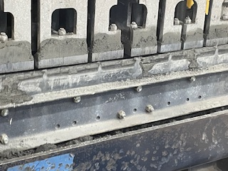
Cut-off Bar
The front gate of the feedbox that has teeth and a wiper that match with the mold when it comes out to pull back excess material.

Slide 30
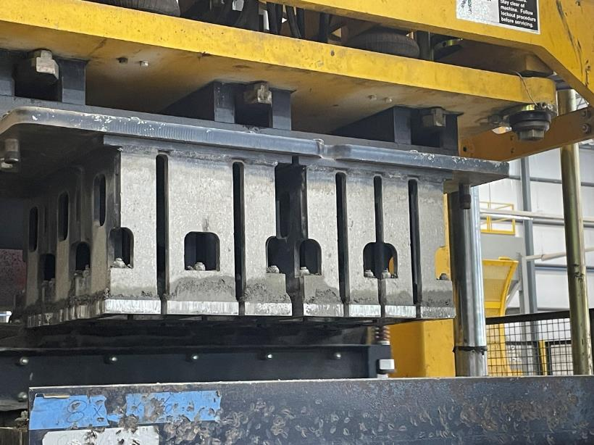
Tamper Head/Mold Head
The part of the mold that compresses on the material to form a block in the mold and aids in stripping of the blocks. Includes the stripper plate, plungers, and shoes.

Slide 31
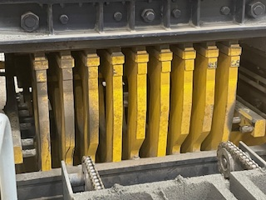
Pallet Receiver
Lifts a pallet under the mold for compaction.

Slide 32
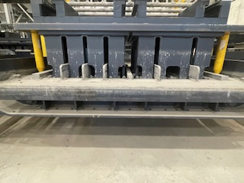
Mold
The tool inserted in the machine responsible for forming the block to industry-standard specs.

Slide 33
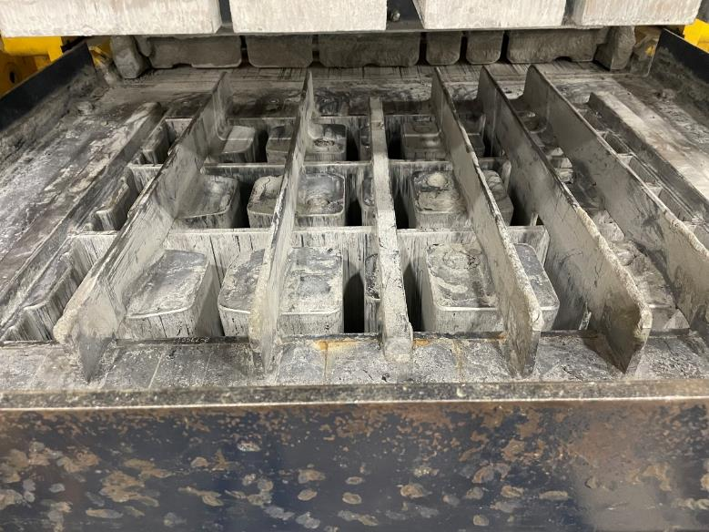
Assembled Mold Bottom
Holds the material in specific specs for compression. Contains the top frame, core assemblies, division plates, and side core bars.

Slide 34
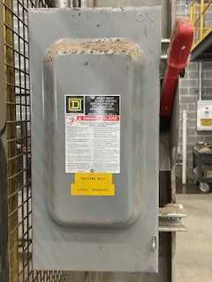
Machine Belt Disconnect Switch
Powers the machine belt.

Slide 35
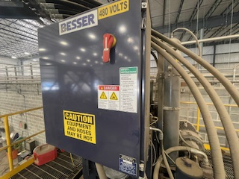
Hydraulics Electrical Control Panel
Controls the hydraulic flow and functions of the block machine.

Slide 36
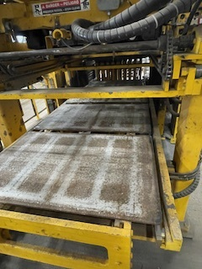
Pallet Delivery System
The part of the machine that receives pallets from the pallet magnet, and delivers them to the pallet receiver.

Slide 37
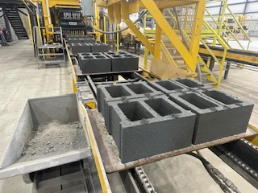
Front Delivery Conveyor
Conveys pallets from the block machine to the Bessermatic.

Slide 38
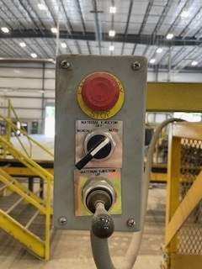
Pallet Rejector Controls
Controls the pallet rejector and located on top of the front delivery conveyor.

Slide 39
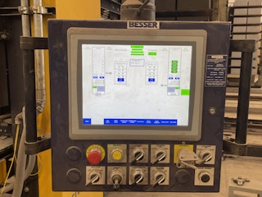
Bessermatic Control Panel
The control panel that controls actions and operations of the bessermatic.

Slide 40
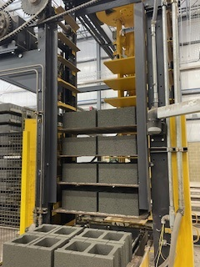
Bessermatic Loader (Loading side)
Loads pallets onto a rack for delivery into the kiln room.

Slide 41
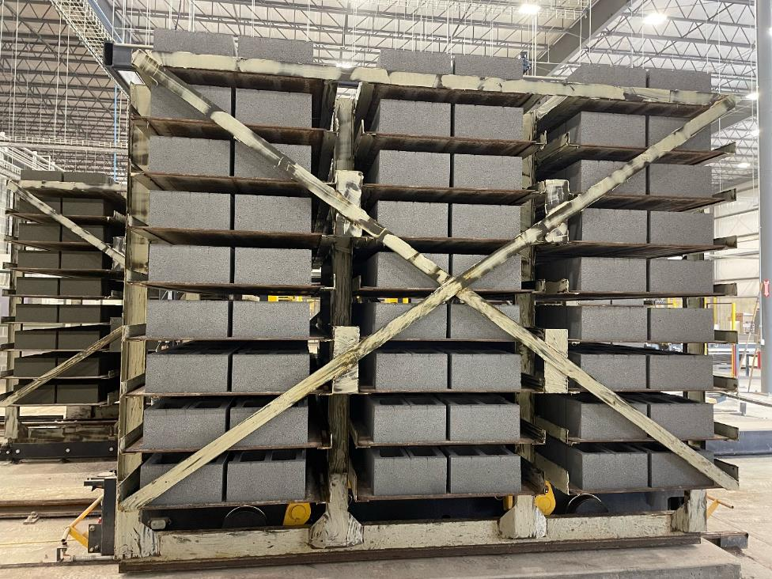
Rack
A steel shelving unit that holds 108 pallets. Stores 9 pallets high, 4 pallets deep, and 3 pallets wide.

Slide 42
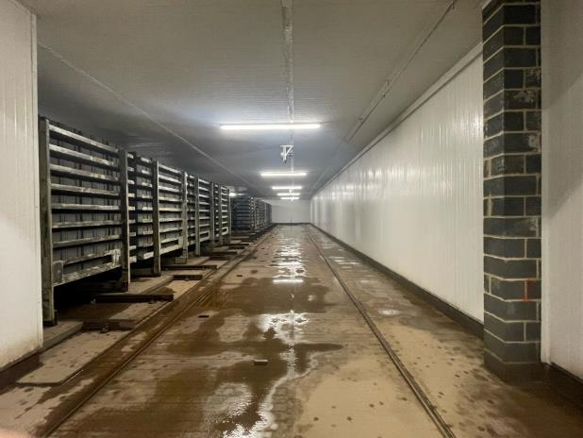
Kiln Room
Kiln Room: An insulated room where wet blocks are stored to be cured.
Cured: Providing adequate moisture, temperature, and time to allow the concrete to achieve the desired properties for its intended use.

Slide 43
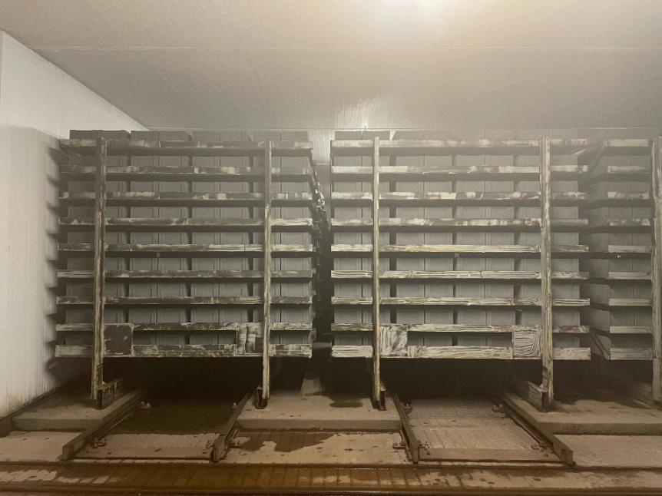
Bay
A row of racks in the Kiln. There are 13 bays in the new Besser plant. One bay can hold up to 4 racks.

Slide 44

Car
The unit that takes racks in the kiln to be cured and removed to be palletized. It is also where the crawler is stationed during transport.

Slide 45

Crawler
The unit that loads and unloads racks in either a bay or the bessermatic system.

Slide 46

Bessermatic Unloader (Unloading Side)
Unloads cured blocks onto the unloading conveyor.

Slide 47



Unloading Conveyor
The conveyor that conveys pallets from the unloader to the pallet turnover.

Slide 48

Pallet Scraper Control Panel
The Pallet Scraper Control Panel controls the pallet scraper that clears debris from the pallets before they are stacked to use again. The panel will run on auto as well as allows you to manually control moving the pallets backwards and forwards.

Slide 49

Pallet Scraper
The Pallet scraper removes any debris still on the pallet before it is stacked and used again for more blocks.

Slide 50

Pallet Turnover
Flips pallets 180 degrees to ensure both sides of the pallet are being used for blocks.

Slide 51

Turnover Controls
Controls the rollover either automatically or manually. Located to the right of the rollover.

Slide 52

Pallet Magazine
Where all empty pallets are loaded after going through the Unloading Conveyor. Loaded in queue for the pallet magnet from the bottom up.

Slide 53

Pallet Magazine Controls
Controls the pallet magazine either automatically or manually. Located to the left of the magazine.

Slide 54

Pallet Magnet and Delivery
Uses air pressure and an electromagnet to load pallets into the block machine.
Where the pallet magnet drops off pallets in the block machine. Waits in queue for its turn in cycle.

Slide 55

Besser 2.0 Dryside

Slide 56

Depalleter Panel
The Depalleter Panel controls the Depalleter which unloads the blocks from the pallets and moves then down the platform. This panel controls the:
Simultaneous overhead pushers
Independent side pushers
Turntable
Index

Slide 57

Depalleter Pusher
The Depalleter pusher pushes the blocks off the pallets and onto the turn tables.

Slide 58

Depalleter Turntables
The Depalleter turntables turn the blocks 90° from the position they were when they came off the pallets, to the direction they will be so that they can be aligned in a straight line.

Slide 59

Index Pusher
After the blocks are moved off of the turntable, the Index Pusher pushes the blocks to exit them off of the platform after the indexing and side pusher operation.

Slide 60

Depalleter Dogs Ears
The Depalleter Dogs Ears also known as indexing, push a set of blocks forward so that they can be aligned in the correct orientation to be pushed to the block splitter.

Slide 61

Side Index Pushers
There are two sider pushers on either side of the platform. After the dogs have indexed the blocks correctly, the two pushers on either side will then align the blocks into a straight line.

Slide 62

Online Splitter
The online splitter has a blade that splits the blocks. It splits the blocks right before the block turner.

Slide 63

Turner Clamps
The Turner Clamp turn the blocks that will be on the bottom of the cube.

Slide 64

Offline Splitter
The offline splitter is an alternative option to splitting the blocks. It sits on the side of the conveyer rollers to split the blocks as they come down the rollers.

Slide 65

Splitter/Turnover Panel
The Splitter/turnover panel controls the Inline Splitter and the turnover clamps. It also turns on the hydraulic power unit (HPU), resets the safety curtain, allows programming for the turnover, and aids in cubing of block.

Slide 66


Safety Light Curtain
The Safety Light Curtains.

Slide 67

Hydraulic Tank
Powers the mechanical actions of the splitter and depalleter.

Slide 68

Dryside Conveyer
The dryside conveyer moves the blocks from the Depalleter/ splitter/turnover to the patternmaker. The conveyer is made up of powered rollers.

Slide 69

Dryside Patternmaker
The Patternmaker moves the blocks from the conveyer rollers, to the turntables where they can be turned and moved according to the pattern selected before they are moved along to the cuber.

Slide 70

Dryside Panel
The Cuber Panel controls the cuber machine, patternmaker, and the pallet injector programming.

Slide 71

Patternmaker Clamps
Patternmaker clamps allow blocks to move to the shift plates a few at a time to make the pattern of the tiers.
There is a clamp on each side of the block that can be adjusted.

Slide 72

Shift Plate
Part of the patternmaker assembly, the shift plate moves the blocks from the conveyor rollers to the turntables.

Slide 73

Shift Plate Eyes
The shift plate eyes make sure that the blocks are in the proper position and correctly aligned. If blocked, they will stop the operation.
NOTE: The eyes are positioned to read the amount of blocks pushed onto the shift plate. The eyes are set up to read positions of 8”, 16”, and 24”.

Slide 74

Turntable
There are four turntables that move blocks to the correct direction depending on the pattern design. These turntables move in either a clockwise or counterclockwise direction.

Slide 75

Dryside Cuber Machine
The Cuber machine includes:
The Cuber Rollers
End stop
Side pushers
Tier pusher
Tier platform
Tier clamps
Tier Injector

Slide 76

Cuber Rollers
The Cuber Rollers move the blocks from the turntables into a row so the tier can be made.

Slide 77

End Stop
The End Stop stops blocks at a predetermined point to help make the tier. The End Stop can be moved for 16-inch blocks and 18-inch blocks.

Slide 78

Side Pusher
The Side Pusher pushes the row of blocks forward to assist in creating a tier layer. The side pusher can be programmed in short, medium, and long pushes.

Slide 79

Tier pusher
Once a tier has been made, the Tier Pusher pushes the tier to the lift platform.

Slide 80

Tier Platform
The Tier Platform moves the tier up to the correct level of cube so that the tier can be placed on top of the cube. The platform moves over top of the tier to put the tier on top of the cube.

Slide 81

Tier Clamps
The Tier Clamps move inwards to hold the tier up while the tier platform reverses from under the tier. Once the tier platform has moved backwards to its home position, the clamps disengage the tier, allowing them to drop onto the rollers or the cube being assembled.

Slide 82

Tier Bar
The Tier Bar prevents the block from moving backwards while the Tier Platform reverses from under the tier.

Slide 83

Pallet Ejector
The Pallet Ejector places a wooden pallet onto the rollers to allow tiers to be cubed upon.

Slide 84

Pallet Ejector (slide 2)
The Pallet Ejector places a wooden pallet onto the rollers to allow tiers to be cubed upon.

Slide 85

Exit Conveyer
The Exit Conveyer is the conveyer that brings the cube made in the cuber to the exit conveyer where it can be picked up and taken to the yard by a forklift.

Slide 86

Cuber pumps
The pallet pump.

Slide 87

Pallet Dispenser Panel
The Pallet Dispenser Panel controls the pallet injector dispensing the pallets as well as being able to manually move the pallet dispenser and the dispenser forks.

Slide 88

Fortress Key Panel
The Fortress key panel holds the safety keys that allow the machines to run. Without the key, a machine will not run. The keys are interchangeable. To take a key out of the panel, you must take a key from a control panel and put it in the key panel. Then you may remove a key for a guard gate.

Slide 89

Guard Gate
Guard gates encompass some Besser machinery to ensure that workers are safe when working around the equipment. The Guard Gate allows workers to go beyond the guard fencing to work on machines. These gates are interlocked with the machine through a fortress key system.

Slide 90

Fortress Guard Gate Lock
These keyed locks are interlocked with a specific machine. The point of the interlock is to prevent the machines from running while a team member is inside the guarding. Workers can go into the guarded area only if the fortress key has been taken out of the machine and a key has been placed to unlocked the gate.

Slide 91


Vapor Generator
The machine responsible for providing the heat and humidity of the kiln room (inside picture of room on next slide.

Slide 92


Slide 93

Air Compressor
Responsible for providing air pressure for all air drop-downs around the plant, as well as air for all machinery pneumatics.

Slide 94

Control Room
Contains the electrical circuit panels for the HMI monitor on the right and the Bessermatic monitor on the left and the circuit breaker in the middle.

Slide 95


Dryside Catwalk
The catwalks are stairs and a walkway over part of the machine to get from one side of the machine to the other. There is one above the conveyer rollers and one above the Depalleter conveyer.

Slide 96

Mold Rack
The platform that holds molds that are not currently in use.

